Slide 1
Modeling Retail Sales with SARIMA
David Culhane
DSC 630-T301
Professor Andrew Hua

Slide 2
Introduction
Retail sales modeling helps retailers make decisions about staffing and inventory
Higher quality models would be business assets

Slide 3
About SARIMA Modeling
Seasonal Autoregressive Integrated Moving Average
“Seasons” defined for periods of repetition to capture
Auto-regresses data within small windows
Error in model building kept track of using moving averages
Integration via differentiation of data for smoothing
Uses time series data
Can make use of external/exogenous information

Slide 4
Data Selection and Preparation
Used retail sales data from an anonymized retail chain in three CSVs:
stores.csv contained information on the stores
features.csv contained weekly economic sales data for each store
Area temperature, fuel price, consumer price index value, unemployment rate, and holiday
sales.csv contained weekly sales information for each department
Found on Kaggle (Singh)
Merged to create a dataset where each row represented one week in one department with its sales data, economic information, and store data

Slide 5
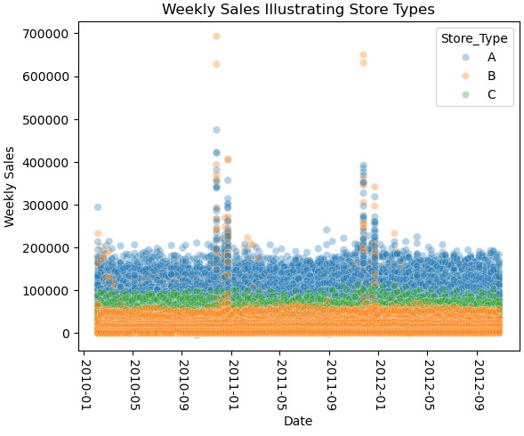
Data Preparation: Exploration
Plotted weekly sales for each department throughout the data
Store A has higher sales volume
Store C has mid-tier sales volume
Store B has lower sales volume
Decided to split stores into different datasets by store type

Slide 6
Data Preparation: Selecting Stores
The models being used require time series data from a single group, so department 1 from stores 1 (A), 3 (B), and 30 (C), were chosen
Resulting subsets had 143 rows of data spanning from February 2010 through October 2012

Slide 7
Data Preparation: Training and Testing Sets
The data was split into training and testing sets on April 1, 2012
Training data contained 113 rows, just under 80% of the total data
Testing data contained 30 rows, just over 20% of the total data
Allowed for multiple years of training data

Slide 8
SARIMAX from statsmodels
Endogenous Data: Time series data being projected
Exogenous Data: Additional contextual data
Order Parameters: (p, d, q)
Seasonal Order Parameters: (P, D, Q, m)
p/P and q/Q values chosen from analyzing ACF (q/Q) and PACF (p/P) plots
m (52) representing the amount of data each period

Slide 9
auto_arima from pmdarima
Uses a step-by-step search algorithm to find the best parameters for p/P and q/Q
Minimum and maximum values for parameters can be set to create the search space
One model could be the selection from many models initially tested
Scored by either mean squared error or mean absolute error
Computationally expensive due to the number of models created
Can be limited using various parameters in the function

Slide 10

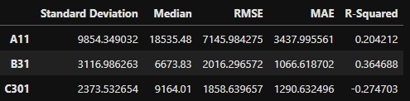
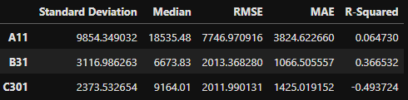
Results and Model Comparison
Results compared visually and using root mean squared error (RMSE) and mean absolute error (MAE)
Standard deviations of weekly sales and median values for each store and department were included to inform interpretation
Mean not included due to holiday outliers
MAE consistently a fraction of standard deviation and median values
RMSE carries higher penalties for errors and tended to be larger
SARIMAX Metrics
auto_arima Metrics

Slide 11
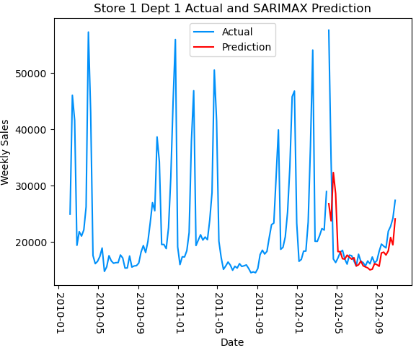
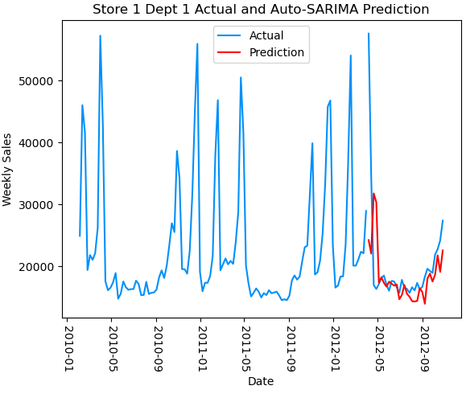
Store 1, Department 1
Predictions tended to undershoot the actual data
Otherwise followed trends well
Non-holiday sales tending to range between $10,000 and $20,000
Store type tending to have the highest sales volume

Slide 12
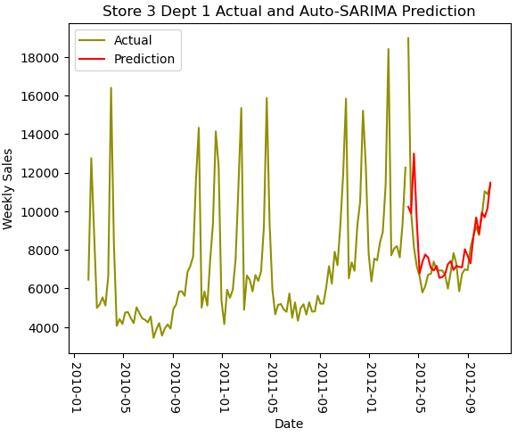
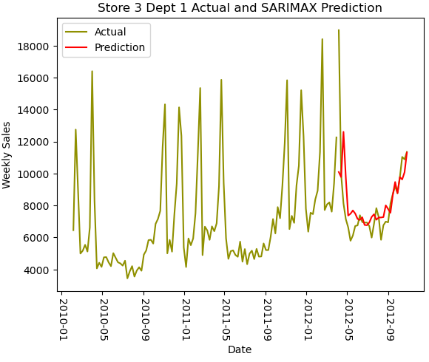
Store 3, Department 1
Projections tended to overshoot the actual data
Otherwise followed trends well
Non-holiday sales ranging between $4,000 and $6,000
Store type tending to have the lowest sales volume

Slide 13
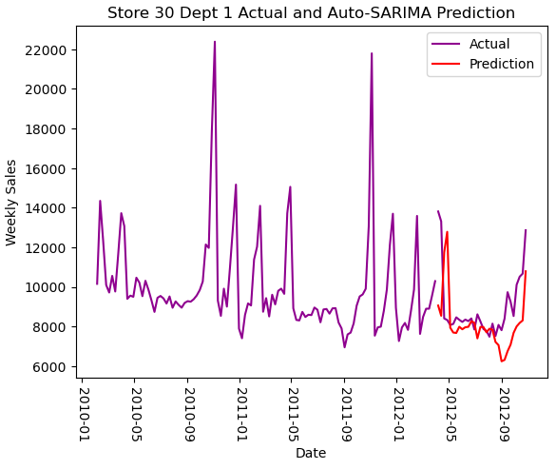
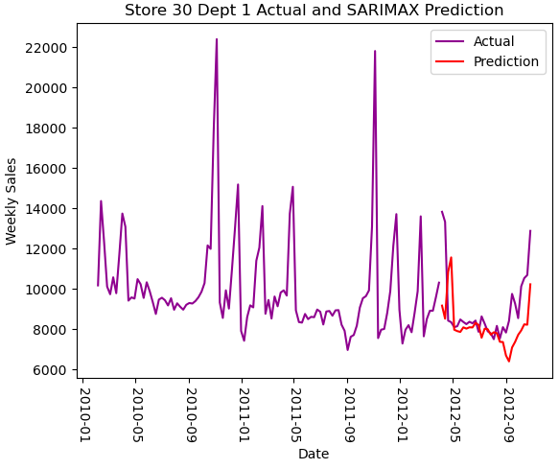
Store 30, Department 1
Projections mimicked behavior in September 2011
Responsible for large deviation between projections and actual weekly sales data
Possibly due to influence of exogenous economic data
Projections tended to undershoot the data
Non-holiday sales ranging between $8,000 and $11,000

Slide 14
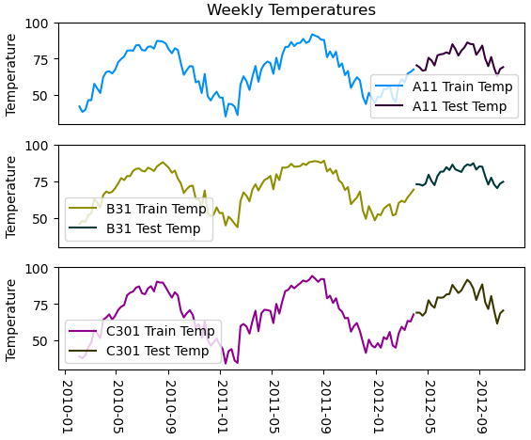
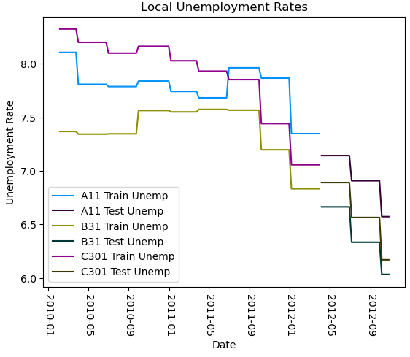
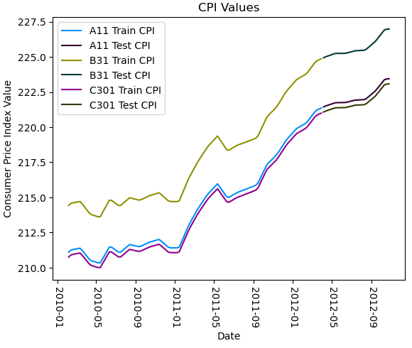
Influence of Economic Data
Fuel data was not used in the model due to it being the national average instead of a local average
Holiday flags correlate to large spikes in sales
Trends in local unemployment and temperature helped inform model projections
Markdown field removed for lack of data before November 2011
Local Consumer Price Index followed similar trajectories for each store

Slide 15
Conclusion
SARIMA modeling was a good choice for retail sales projections
Additional data would make model creation more robust
SARIMAX models are more efficient but require parameters to be specified
Better for individual creations
auto_arima models require less input but are more expensive computationally
Better for creating many different models at the same time

Slide 16
References
Brownlee, J. (2019, August 21). A Gentle Introduction to SARIMA for Time Series Forecasting in Python. Retrieved from Machine Learning Mastery: https://machinelearningmastery.com/sarima-for-time-series-forecasting-in-python/
Justin, L. a. (2022, September 7). How to build ARIMA models in Python for time series forecasting. Retrieved from Youtube: https://youtu.be/-aCF0_wfVwY?si=zB6hYwpk5-N7MPZ4
SARIMAX. (2024, October 3). Retrieved from statsmodels: https://www.statsmodels.org/stable/generated/statsmodels.tsa.statespace.sarimax.SARIMAX.html#statsmodels.tsa.statespace.sarimax.SARIMAX
Singh, M. (2017). Retail Data Analytics. Retrieved from Kaggle: https://www.kaggle.com/datasets/manjeetsingh/retaildataset
TeKnowledGeeK. (2021, October 21). Time Series Forecasting using SARIMAX and compared with ARIMA. Retrieved from Youtube: https://youtu.be/JO0gFP_q4uc?si=HAYi1WxAkZWEM3yp

